Slide 1
Max Flow on Pedestrian Transit Networks
Sasha Dolynuk, Alfonso Meraz, Mark Nudelman,
Justin Sadler, Nathaniel Voss

Slide 2
Outline
Brief history of combinatorial methods for the max flow problem
Implementation using Ford-Fulkerson (Edmonds-Karp) on 2 transit problems
Transit Problems
Approach/Tech Stack
Algorithm performance
Insights/Analysis
Takeaways
Notes:
Nat
First, why not linear time?!
Overly involved implementation - more optimization focused (i.e. EC524) than data structures … Combinatorial vs Linear Optimization (“Programming”) Approach- utilizing approximation methods

Slide 3
Brief History of Combinatorial Advances: Timeline
1959
1970, 1972
1974
1980, 1982
1988
Ford and Fulkerson [1]
Dinic [2],
Edmonds and Karp [3]
Karzanov [4]
Galill and Naamad [5],
Sleator and Tarjan [6]
Goldberg and Tarjan [7]
Augmenting Paths
Residual Graphs
Data Structures
Dynamic Trees
Push-Relabel
Blocking Flows
Levels Graph
BFS
Preflows
– Push-balancing
Notes:
Nat

Slide 4
Brief History of Combinatorial Advances: Timeline
First solution
1959
Ford and Fulkerson
Augmenting Paths
Residual Graphs
Notes:
Nat

Slide 5
Brief History of Combinatorial Advances: Timeline
First solution
Ford and Fulkerson [1] Approach
→ Find: Augmenting paths
→ Update: Residual graph
→ Repeat
1959
Ford and Fulkerson
Augmenting Paths
Residual Graphs
Notes:
Nat

Slide 6
Brief History of Combinatorial Advances: Timeline
First solution
Ford and Fulkerson [1] Approach
→ Find: Augmenting paths
→ Update: Residual graph
→ Repeat
Complexity:
Indeterminate if flow is irrational numbers
O(Ef) if capacities are integers, (where f = max flow)
1959
Ford and Fulkerson
Augmenting Paths
Residual Graphs
Notes:
Nat

Slide 7
Brief History of Combinatorial Advances: Timeline
Augmenting along shortest paths
1959
1970, 1972
Ford and Fulkerson
Dinic
Edmonds and Karp
Augmenting Paths
Residual Graphs
Blocking Flows
Levels Graph
Breadth First Search
Notes:
Nat

Slide 8
Brief History of Combinatorial Advances: Timeline
Augmenting along shortest paths
Dinic [2]: Levels
→ Create: Levels Graph
→ Find: Blocking flows for each augmented path along that level
→ Update: Levels graph (shortest levels)
→ Repeat: for next level (layer), monotonically increasing
1970, 1972
Dinic
Edmonds and Karp
Blocking Flows
Levels Graph
Breadth First Search
Notes:
Nat

Slide 9
Brief History of Combinatorial Advances: Timeline
Augmenting along shortest paths
Dinic [2]: Levels
→ Create: Levels Graph
→ Find: Blocking flows for each augmented path along that level
→ Update: Levels graph (shortest levels)
→ Repeat: for next level (layer), monotonically increasing
Complexity:
O(EV^2) time, O(E) space
1970, 1972
Dinic
Edmonds and Karp
Blocking Flows
Levels Graph
Breadth First Search
Notes:
Nat

Slide 10
Brief History of Combinatorial Advances: Timeline
Augmenting along shortest paths
Edmonds-Karp[3]: BFS
→ Creates: bounded structure for the Ford Fulkerson Alg, even for irrational flows
→ Use: Breadth First Search order to examine paths in the Ford Fulkerson Algorithm
- monotonically increasing
1970, 1972
Dinic
Edmonds and Karp
Blocking Flows
Levels Graph
Breadth First Search
Notes:
Nat

Slide 11
Brief History of Combinatorial Advances: Timeline
Augmenting along shortest paths
Edmonds-Karp[3]: BFS
→ Creates: bounded structure for the Ford Fulkerson Alg, even for irrational flows
→ Use: Breadth First Search order to examine paths in the Ford Fulkerson Algorithm
- monotonically increasing
Complexity:
O(VE^2) time, O(E) space
1970, 1972
Dinic
Edmonds and Karp
Blocking Flows
Levels Graph
Breadth First Search
Notes:
Nat

Slide 12
Brief History of Combinatorial Advances: Timeline
Breaking Conservation of Flow
1959
1970, 1972
1974
Ford and Fulkerson [1]
Dinic [2]
Edmonds and Karp [3]
Karzanov [4]
Augmenting Paths
Residual Graphs
Blocking Flows
Levels Graph
BFS
Preflows
– Push-balancing
Notes:
Nat

Slide 13
Brief History of Combinatorial Advances: Timeline
Breaking Conservation of Flow
Karzanov[4]: Preflow
allows for violating the conservation of flow of transit nodes (not source or sink) with the concept of excess flow (akin to reservoirs at the nodes)
→ Send: preflows into vertex rather than across augmenting paths
→ Use: levels approach (uses global (path) distances) sending preflows for each level
- monotonically increasing
→ Rebalance: restore conservation constraint
→ Repeat: Next level
1974
Karzanov [4]
Preflows
– Push-balancing
Notes:
Nat

Slide 14
Brief History of Combinatorial Advances: Timeline
Breaking Conservation of Flow
Karzanov[4]: Preflow
allows for violating the conservation of flow of transit nodes (not source or sink) with the concept of excess flow (akin to reservoirs at the nodes)
→ Send: preflows into vertex rather than across augmenting paths
→ Use: levels approach (uses global (path) distances) sending preflows for each level
- monotonically increasing
→ Rebalance: restore conservation constraint
→ Repeat: Next level
Complexity: O(V^3) time, O(V^2) space
1974
Karzanov [4]
Preflows
– Push-balancing
Notes:
Nat

Slide 15
Brief History of Combinatorial Advances: Timeline
Breaking Conservation of Flow
Karzanov[4]: Preflow
allows for violating the conservation of flow of transit nodes (not source or sink) with the concept of excess flow (akin to reservoirs at the nodes)
→ Send: preflows into vertex rather than across augmenting paths
→ Use: levels approach (uses global (path) distances) sending preflows for each level
- monotonically increasing
→ Rebalance: restore conservation constraint
→ Repeat: Next level
Complexity: O(V^3) time, O(V^2) space
Useful for future improvements!
1974
Karzanov [4]
Preflows
– Push-balancing
Notes:
Nat

Slide 16
Brief History of Combinatorial Advances: Timeline
Data Structures/Compression
1959
1970, 1972
1974
1980, 1982
Ford and Fulkerson
Dinic
Edmonds and Karp
Karzanov
Galill and Naamad
Sleator and Tarjan
Augmenting Paths
Residual Graphs
Data Structures
Dynamic Trees
Blocking Flows
Levels Graph
BFS
Preflows
– Push-balancing
Notes:
Nat

Slide 17
Brief History of Combinatorial Advances: Timeline
Data Structures/Compression
1959
1970, 1972
1974
1980, 1982
Ford and Fulkerson
Dinic
Edmonds and Karp
Karzanov
Galill and Naamad
Sleator and Tarjan
Augmenting Paths
Residual Graphs
Data Structures
O(EVlog^2V), O(E)
Dynamic Trees
O(EVlogV)
Blocking Flows
Levels Graph
BFS
Preflows
– Push-balancing
Notes:
Nat

Slide 18
Brief History of Combinatorial Advances: Timeline
Combining approaches
1959
1970, 1972
1974
1980, 1982
1988
Ford and Fulkerson
Dinic
Edmonds and Karp
Karzanov
Galill and Naamad
Sleator and Tarjan
Goldberg and Tarjan
Augmenting Paths
Residual Graphs
Data Structures
Dynamic Trees
Push-Relabel
Blocking Flows
Levels Graph
BFS
Preflows
– Push-balancing
Notes:
Nat

Slide 19
Brief History of Combinatorial Advances: Timeline
Combining approaches
Goldberg and Tarjan[7]: Push-Relabel Method
One of most efficient combinatorial solutions
Improves on Karzanov’s approach
→ Examines: single arc, nodes at time using preflow at local level
- using node height labels, node excess function
→ Move along and update heights upon each push at the local (nodes) level
→ Push back excess: updating height and excess flow values
1988
Goldberg and Tarjan
Push-Relabel
Notes:
Nat

Slide 20
Brief History of Combinatorial Advances: Timeline
Combining approaches
Goldberg and Tarjan[7]: Push-Relabel Method
One of most efficient combinatorial solutions
Improves on Karzanov’s approach
→ Examines: single arc, nodes at time using preflow at local level
- using node height labels, node excess function
→ Move along and update heights upon each push at the local (nodes) level
→ Push back excess: updating height and excess flow values
Complexity:
O(V^3) time, O(E) space
… using dynamic trees:
O(VElog((V^2)/E)) time, O(E) space
1988
Goldberg and Tarjan
Push-Relabel
Notes:
Nat

Slide 21
Brief History of Combinatorial Advances: Timeline
And more… O(VE) (2013), O(E^(1+o(1))) (2022)...
1959
1970, 1972
1974
1980, 1982
1988
Ford and Fulkerson
Dinic
Edmonds and Karp
Karzanov
Galill and Naamad
Sleator and Tarjan
Goldberg and Tarjan
Augmenting Paths
Residual Graphs
O(Ef), Indeterminate
Preflows
– Push-balancing
O(V^3), O(V^2)
Data Structures
O(EVlog^2V), O(E)
Dynamic Trees
O(EVlogV)
Push-Relabel
O(V^3), O(E)
Blocking Flows
Levels Graph
O(EV^2), O(E)
BFS
O(VE^2), O(E)
Notes:
Nat:Faster approaches (2013, 2022).. “Modern” Approaches
-Linear Optimization (/programming aka LP solutions) Algs (vs Combinatorial Algs)’.. LP Solver - Simplex Method.. Approximation Methods~Beyond Scope of this Project/Presentation
Why it matters: Able to achieve fastest times for specific max flow problems, including near linear time
Basic structure: outer algorithm, outer algorithm. Use LP approaches, improvement on inner algorithm. Dynamic cycle, min ratios, etc.
Runtime, Space
O(edges^1+o(1)) i.e. E^(1 plus some “very small number”)

Slide 22
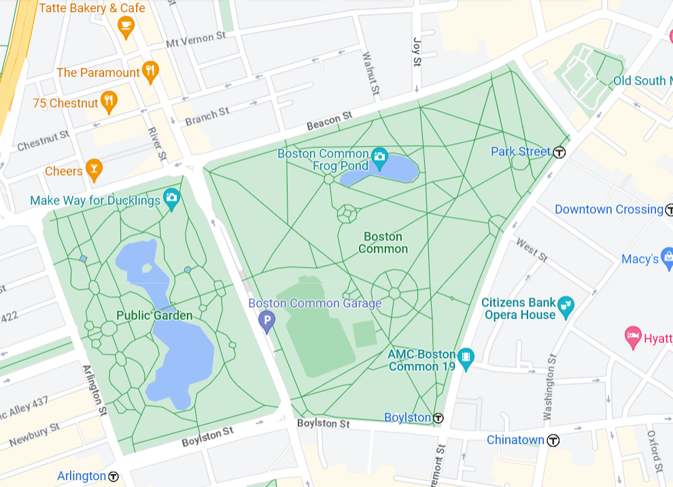
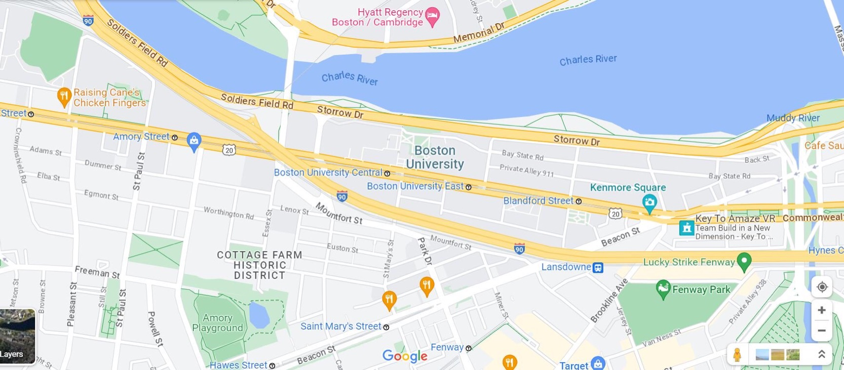
Our Implementation: “pedestrian transit problems”
Scenario 1: Maximum pedestrians that can walk from Raising Cane’s to Kenmore Square for dessert?
Scenario 2: Maximum pedestrians can walk from broken down train at Arlington to Park Street Station?
Notes:
Nat

Slide 23
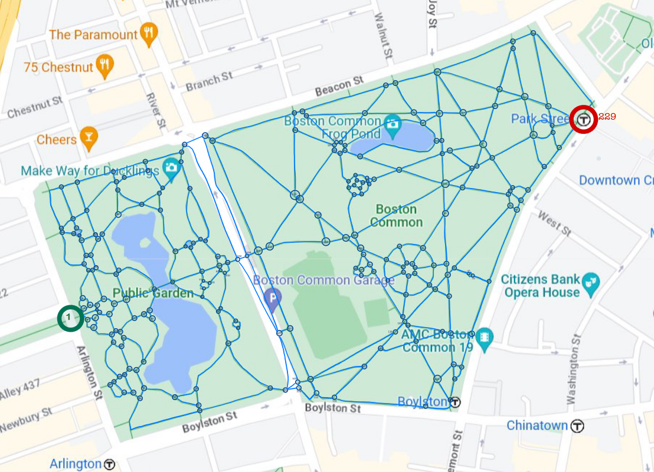
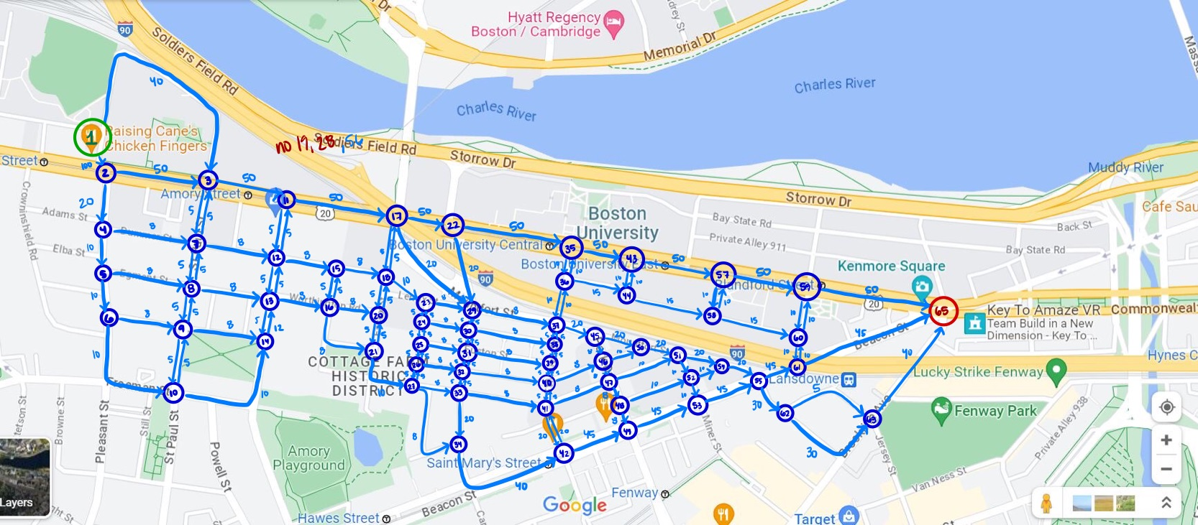
Our Implementation: “pedestrian transit problems”
Scenario 1: Maximum pedestrians that can walk from Raising Cane’s to Kenmore Square for dessert?
Scenario 2: Maximum pedestrians can walk from broken down train at Arlington to Park Street Station?
Notes:
Sasha

Slide 24
Directed Network
Assign node to each intersection and edge to each street used in the flow network
Source: Raising Cane’s
Sink: Kenmore Square
Capacities of edges assigned based on how many people can travel through the street associated with that edge
Notes:
Sasha

Slide 25
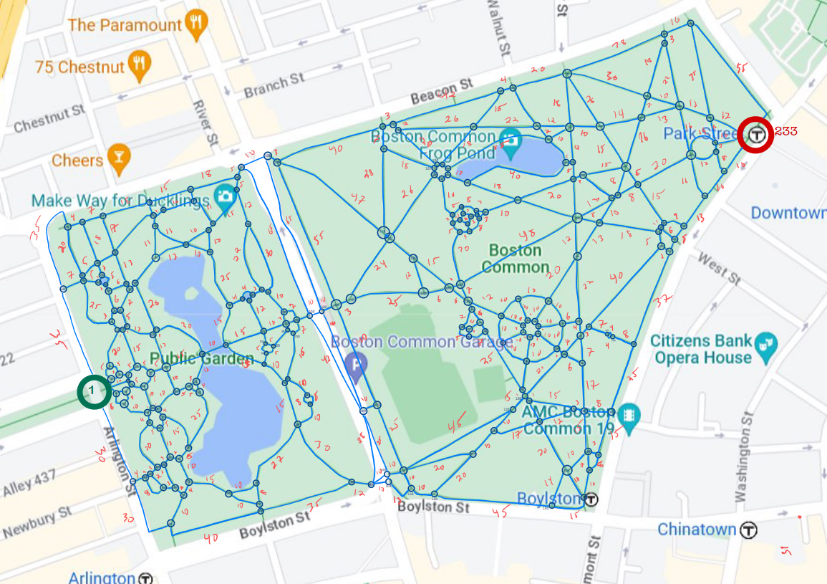
Expanded Nodes
Every Intersection gets a node
Source (Node 1), Sink (Node 233)
Capacity: Assumes standard path width, corresponds to length
Alternative approach: use unit-capacity
Notes:
Sasha

Slide 26
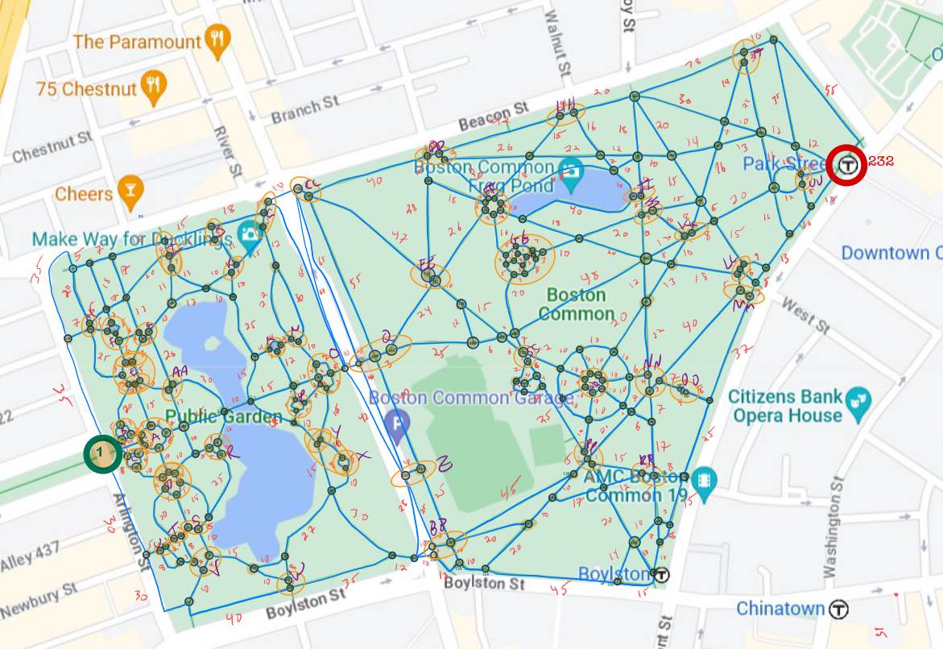
Condensed Nodes
Bundle clusters of nodes at key intersections
Relabel the bundles as single node
Notes:
Sasha

Slide 27
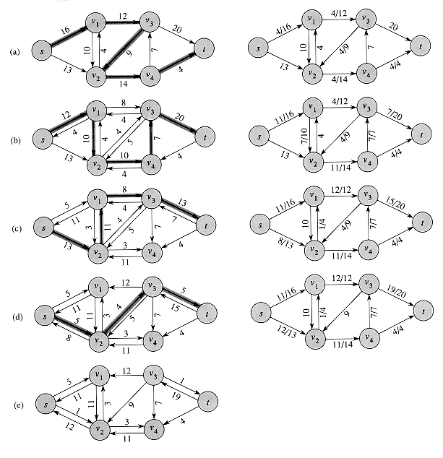
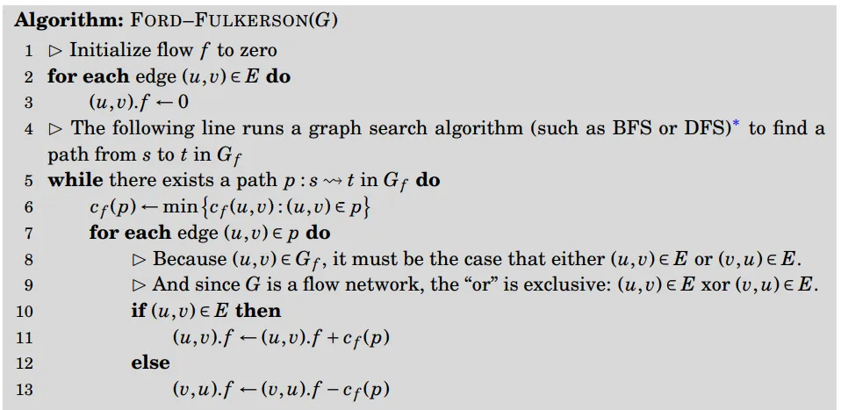
Our Implementation: Approach
Ford-fulkerson (Edmonds-Karp Implementation)
Breadth-First Search -> find shortest path to explore
Creates “residual graph”
Updates flows
Repeats until every flow path optimal
Notes:
Al

Slide 28



Our Implementation: Code/Tech Stack
C++
NetworkX
GNU Plot
Notes:
Al

Slide 29
Findings: Max Flow
Scenario 1: Raising Cane’s → Kenmore Square, capacity based on realistic relative values
Scenario 2: Raising Cane’s → Kenmore Square, unit capacity
Max flow = 66
Max flow = 2

Slide 30

Insights/Analysis: Max Flow
For capacities based on realistic relative values
Limited by flow at the min cut
Min Cut
Max flow = 66 = 50 + 8 + 8

Slide 31
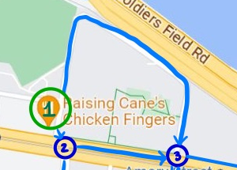
Insights/Analysis: Max Flow
For graph with unit capacity edges
Limited by the 2 edges radiating from the source node
Max flow = 2 = 1 + 1
Min Cut

Slide 32
Findings: Max Flow
Scenario 1: Boston Common network, undirected flow
Scenario 2: Boston Common network, directed flow
Max flow = 22
Max flow = 6

Slide 33
Insights/Analysis
Undirected flow allows for more options to better maximize flow
Directed flow makes assumptions on flow that may not be true - in real life, most streets are 2 way

Slide 34
Findings: Max Flow
Scenario 1: Boston Common network, expanded nodes
Scenario 2: Boston Common network, consolidated nodes
Max flow = 22
Max flow = 44
Consolidate nodes

Slide 35
Insights/Analysis: Max Flow
Consolidating nodes allows for less congestion and bottlenecks
Consolidate nodes → larger max flow
Consolidate nodes

Slide 36
Creating Random Graphs for Testing
Methods: Randomized edge list in C++ for intermediary nodes
PyNetGen: Deprecated Python Library for generating random flow networks
Wilson’s algorithm – Generating uniform spanning trees
Notes:
Justin

Slide 37
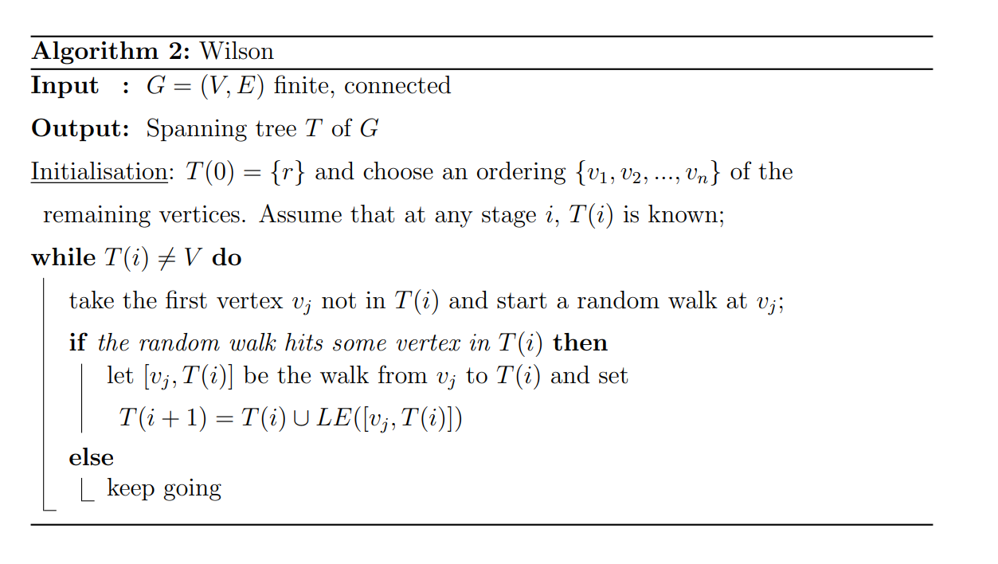
Wilson’s Algorithm
Creates a uniform spanning tree using random walks in a graph.
Guarantees that the graph is connected.
We can add additional capacity arcs and create a random flow network.
Notes:
Justin

Slide 38
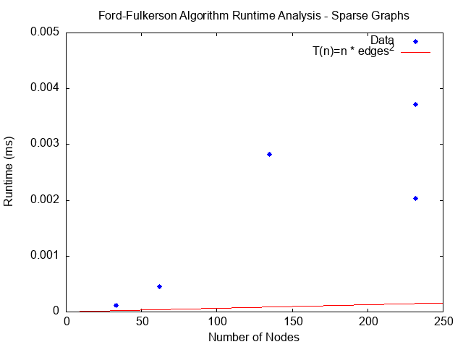
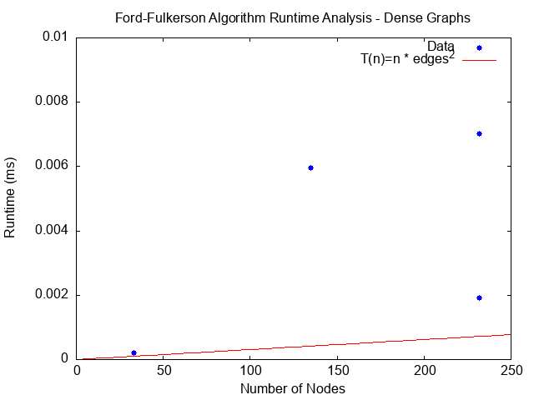
Findings: Algorithm Performance
Notes:
Justin and Mark

Slide 39
Insights/Analysis: Performance
The data collected does not fit the expected performance of O(n * edges^2) for the Edmonds-Karp Algorithm
Graphs maybe are too small to represent the expected asymptotic behavior
Saw a dependence of capacities assigned on runtime
Most likely caused by the graphs not being structured correctly
Graphs need to be more consistently structured
A larger variance of sizes in terms of number of nodes are needed as well
Independently varying number of edges vs independently varying number of nodes
Notes:
Al

Slide 40
Key Takeaways
Development of faster Max Flow algorithms
Effects on Max Flow
Unit capacity vs capacity based on realistic values - unit capacity changes min cut
Directed vs undirected flow - undirected flow is more realistic for 2-way streets, directed edges limits flow
Expanded vs consolidated nodes - condensing nodes reduces bottlenecks and congestion
Runtime analysis

Slide 41
References
[1] Cormen, Thomas H.; Leiserson, Charles E.; Rivest, Ronald L.; Stein, Clifford (2009). "Section 26.2: The Ford–Fulkerson method". Introduction to Algorithms (Third ed.). MIT Press and McGraw–Hill. pp. 651–664. ISBN 0-262-03293-7.
[2] Dinic, E.A. (1970) Algorithm for Solution of a Problem of Maximum Flow in a Network with Power Estimation. Soviet Math Doklady, 11, 1277-1280.
[3] Edmonds, Jack; Karp, Richard M. (1972). "Theoretical improvements in algorithmic efficiency for network flow problems" (PDF). Journal of the ACM. 19 (2): 248–264. doi:10.1145/321694.321699. S2CID 6375478.
[4] Karzanov, Alexander. (1974). Determining the maximal flow in a network by the method of preflows. Doklady Mathematics. 15. 434–437. https://dl.acm.org/doi/10.1145/48014.61051
[5] Zvi Galil, Amnon Naamad,An O(EVIog2V) algorithm for the maximal flow problem,Journal of Computer and System Sciences,Volume 21, Issue 2,1980,Pages 203-217,ISSN 0022-0000,https://doi.org/10.1016/0022-0000(80)90035-5. (https://www.sciencedirect.com/science/article/pii/0022000080900355)
[6] Daniel D. Sleator, Robert Endre Tarjan, A data structure for dynamic trees, Journal of Computer and System Sciences,Volume 26, Issue 3,1983,Pages 362-391,ISSN 0022-0000, https://www.sciencedirect.com/science/article/pii/0022000083900065
[7] Andrew V. Goldberg and Robert E. Tarjan. 1988. A new approach to the maximum-flow problem. J. ACM 35, 4 (Oct. 1988), 921–940. https://doi.org/10.1145/48014.61051
Notes:
All

